Slide 1
Couples Therapy and Depression
Dr. Lloyd Purdy
Tel 604 354 2320
www.seatoskytherapy.com

Slide 2
“Distress in our intimate relationships can be depressing … and depression can contribute to distress in our intimate relationships.”
Notes:
Through our own personal experience I think we can all intuitively understand this circular and mutually reinforcing relationship – and not only that but this is also supported by empirical research

Slide 3
“Couples therapy is an effective treatment for depression offering benefits beyond the reduction of depressive symptoms”
Notes:
While this is also supported by empirical research , I want to leave you all with a taste of what couples therapy might be like as an experience – professional who refers ; friends/family; personally affected as individual

Slide 4
Couples Therapy and Depression – How do we know it works?
Meta-analysis - Cochrane review of all studies up until 2006 to examine the question of Marital Therapy for Depression (Barbato & D’Avanzo 2006, 2008):
Marital therapy at least as effective as either individual therapy or medication irrespective of the presence of marital distress
Marital distress significantly lower and persistence of marital distress significantly less in marital therapy group compared to the individual treatment groups
Study by Atkins et al (2009) concluded … “marital therapy” offers additional benefit of improvements in relational distress beyond what could be expected from improvements in depressive symptoms alone, whilst individual cognitive therapy did not.
Notes:
Meta-analysis - This is the analysis of pooled results from numerous studies. It is the highest level of evidence one can achieve as it suggests a consistent answer across numerous studies.
Marital therapy – most studies did not have a depression focus
Marital distress = couple distress = relationship distress = dyadic dischord
Who wouldn’t want to improve their relationship with their partner while at the same time improving symptoms of depression? … but why else important?

Slide 5
Why is an improvement in relational distress important?
Denton et al (2010) … “dyadic discord” was associated with lack of remission in those offered acute treatment for chronic depression with either individual cognitive therapy, medication or a combination of both.
Those without the “dyadic discord” condition were 2.8 x more likely to achieve remission
Raised the question whether couples therapy for dyadic discord may increase remission rates for difficult to treat chronic depression
Notes:
Interestingly there may be a clue to answering this question contained in a study from 10 years before this – the LDIT which was criticised for containing a possible selection bias for those with severe and chronic depression but which showed encouraging results from Systemic Couple’s therapy with those showing “dyadic discord” in the form of high EE.

Slide 6
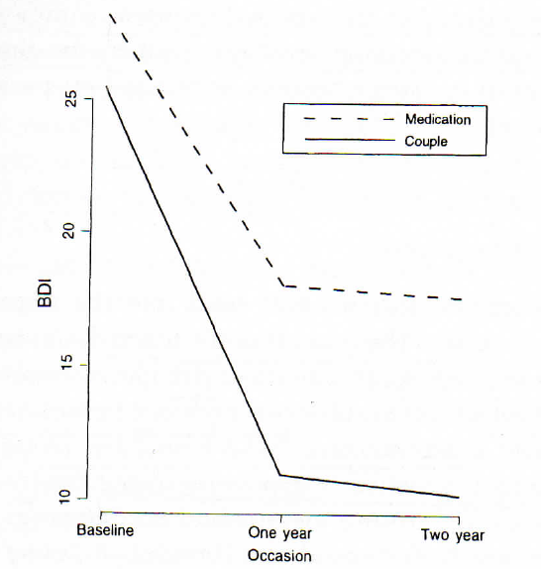
London Depression Intervention Trial
Leff et all (2000) – 3 Arm trial : 1 year of treatment with Systemic Couples Therapy vs Individual CBT vs Medication alone for individuals with depression and partners that demonstrated high levels of Expressed Emotion
Systemic Couples Therapy significantly better than Medication for relief of depressive symptoms at the end of treatment … and after 2 years follow-up
Drop out rate for Systemic Couples Therapy 15% and for Medication 56.8%

Slide 7
What is Systemic Couples Therapy? Theoretical overview
Interactional & Contextual
Values Multiple perspectives
Circular and Reflexive
Resource Orientated
Notes:
Interested in and curious about the interactions between the couple and the various contexts in which they find themselves…How one person responds to the behaviour of another , and the meaning that each of them attributes towards this. Now it is context that gives meaning to an interaction – whether that be historical context or the current context of a situation. There are multiple contexts that can be drawn on to establish the meaning of a situation and hence the need to value multiple perspectives – not least of which is the valuing of the perspective of each of the individuals in the couple relationship. The meaning that arises out of these various contexts drives strong emotions (including the a whole range of emotions which we sometimes describe as “depression”) …. These emotions ,in turn, affect behaviour and the couple’s responses to each other which brings us back to their interaction and the beginning of a cycle – hence circularity is an important part of understanding the problem, potential solutions , and avoiding blame inherent in linear thinking. Now whilst we may be able to identify circular interactions between the couple and the various contexts in which this takes place , I also recognise that one of these contexts is that of the therapeutic relationship – the very fact that I am involved creates a new context and so I need to remain aware of this influence and constantly monitor and review thisit , being wary of being drawn into an illusion of objectivity …my involvement affects what is going on – this is what we term reflexivity. And then Finally in terms of a resource orientated practice , while I am on the look out for vicious cycles to describe and understand a problem …. I am even more interested in looking out for virtuous cycles of interaction and facilitating or amplifying these. It also means that I look toward multiple contexts as also contain multiple resources, strengths and possibilities to allow movement and change to happen

Slide 8
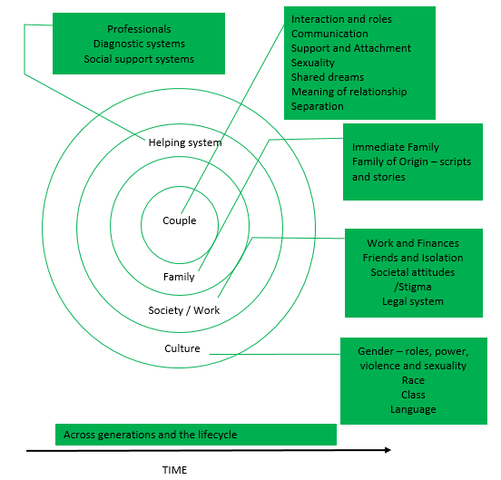
Notes:
This is a diagram of some of the various contexts we might look to in order to understand a situation and discover fresh perspectives that might lead to positive change

Slide 9
References
Atkins, D. Dimidjian, S. Christensen, A. Bedics, J. (2009) Couple discord and Depression in Couples during Couple Therapy and in Depressed Individuals during Depression Treatment. Journal of Consulting and Clinical Psychology 77: 1089-1099
Barbato A, D'Avanzo B. Marital therapy for depression. Cochrane Database of Systematic Reviews 2006, Issue 2. Art. No.: CD004188. DOI: 10.1002/14651858.CD004188.pub2., retrieved from http://mrw.interscience.wiley.com/cochrane/clsysrev/articles/CD004188/frame.html on 29.5.10
Barbato, A. & D’Avanzo, B. (2008) Efficacy of couple therapy as a treatment for depression: A Meta-Analysis. Psychiatric Quarterly 79: 121-132
Denton, W. et al (2010) Dyadic discord at baseline is associated with lack of remission in the acute treatment of chronic depression. Psychological Medicine. 40: 415-424
Leff J, et al (2000) The London Depression Intervention Trial. Randomised controlled trial of antidepressants v. couples therapy in the treatment and maintenance of people with depression living with a partner: clinical outcome and costs. Br J Psychiatry 177:95-100.

